Slide 1

Java and TDD Coding Dojo (Session 3)

Slide 2
Agenda
- Working With Java Data Types
- Primitive Variables
- Identifiers
- Object reference variables
- Operator types and the relevant operators
- Assignment operators
- Arithmetic operators
- Implicit widening of data types in an arithmetic operation
- Relational operators
- Logical operators
- Operator precedence
- Wrapper classes

Slide 3
Coding Dojo Rules
- Respect
- No one know more than other. We all are equal
- Help your peer
- Be cool
- Repeat until you know and do it fast…..

Slide 4
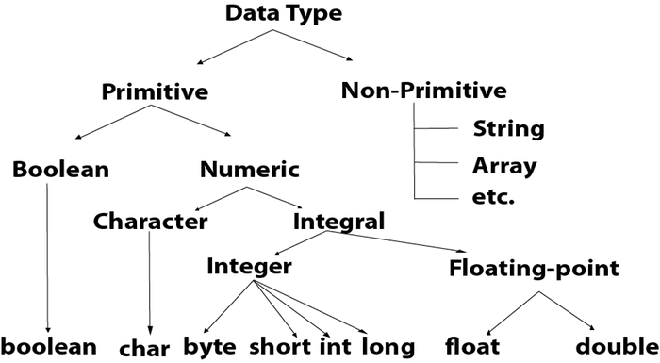
Working With Java Data Types

Slide 5
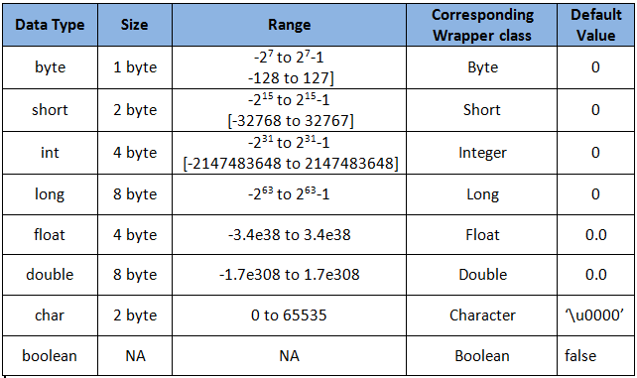
Primitive Variables

Slide 6
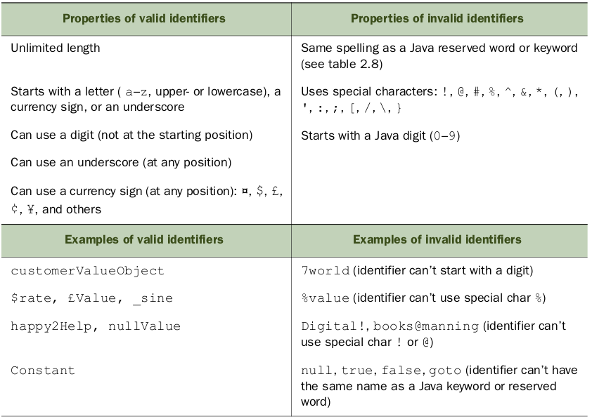
Identifiers
Identifiers are names of packages, classes, interfaces, methods, and variables.

Slide 7
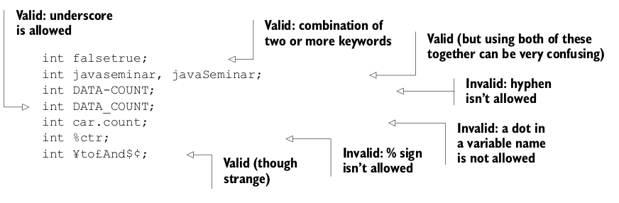
Identifiers (cont.)

Slide 8
Object reference variables
The variables in Java can be categorized into two types: primitive variables and reference
Variables.
Reference variables are also known as object reference variables or object references.
What are object reference variables?
Objects are instances of classes, including both predefined and user-defined classes. For
a reference type in Java, the variable name evaluates to the address of the location in
memory where the object referenced by the variable is stored. An object reference is, in
fact, a memory address that points to a memory area where an object’s data is located.

Slide 9
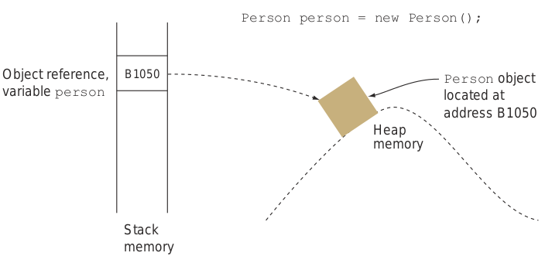
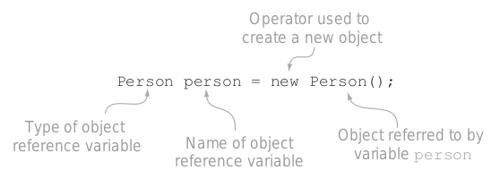
What are object reference variables?
Objects are instances of classes, including both predefined and user-defined classes. For a reference type in Java, the variable name evaluates to the address of the location in memory where the object referenced by the variable is stored. An object reference is, in fact, a memory address that points to a memory area where an object’s data is located.
When an object is instantiated with the new operator, a memory address value to that object is returned. That address is usually assigned to the reference variable.
When the statement “Person person = new Person()” executes, three things happen:
1. A new Person object is created.
2. A variable named person is created in the stack with an empty ( null ) value.
3. The variable person is assigned the memory address value where the object is located.

Slide 10
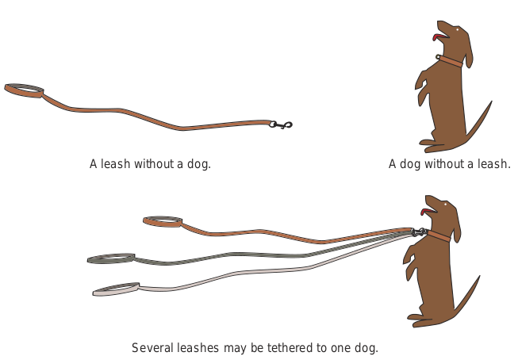
Analogy to understand object reference variables
Think of objects as analogous to dogs, and think of object references as analogous to leashes.
- A leash not attached to a dog is a reference object variable with a null value.
- A dog without a leash is a Java object that’s not referred to by any object reference variable.
- Just as an unleashed dog might be picked up by animal control, an object that isn’t referred to by a reference variable is liable to be garbage collected (removed from memory by the JVM).
- Several leashes may be tethered to a single dog. Similarly, a Java object may be referenced by multiple object reference variables.
The default value of all types of object reference variables is null.
Person person = null;
In this case, the reference variable person can be compared to a leash without a dog.

Slide 11
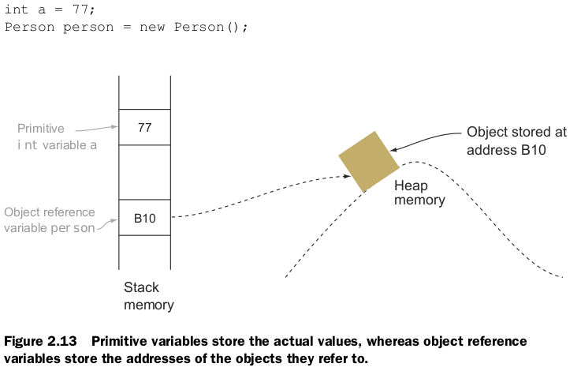
Differentiating between object reference variables and primitive variables

Slide 12
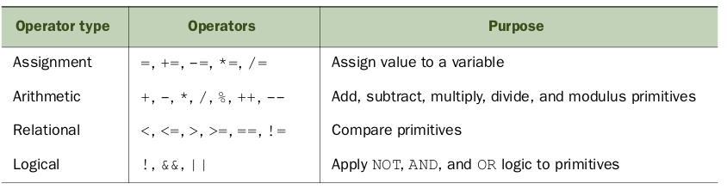
Operator types and the relevant operators

Slide 13
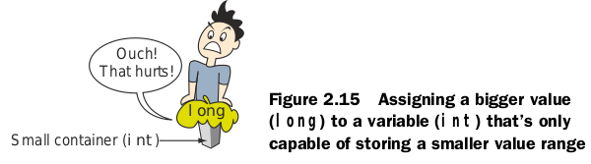
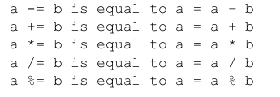
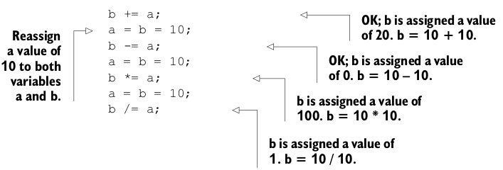
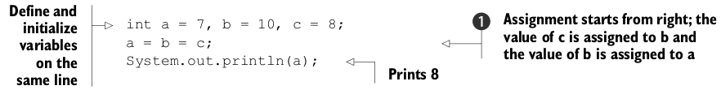
Assignment operators
You can still assign a bigger value to a variable that can only store smaller ranges by explicitly casting the bigger value to a smaller value.

Slide 14
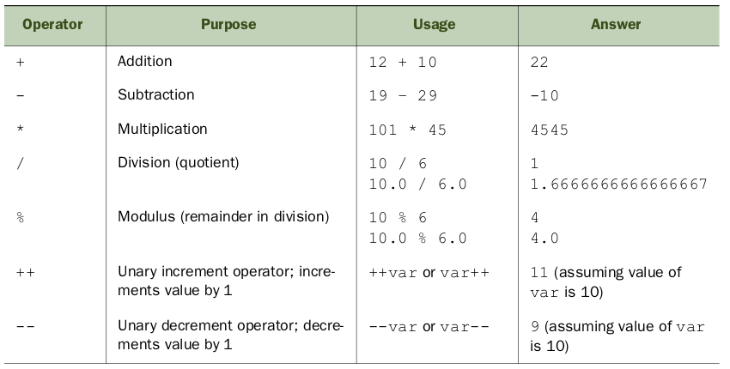
Arithmetic operators

Slide 15
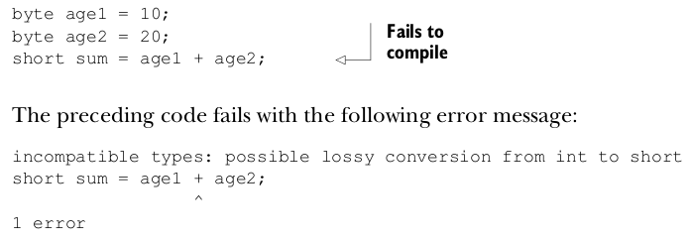
IMPLICIT WIDENING OF DATA TYPES IN AN ARITHMETIC OPERATION
For arithmetic operations with data types char , byte , short , or int , all operand values are widened to int . If an arithmetic operation includes the data type long , all operand values are widened to long . If an arithmetic operation includes a data type of float or double , all operand values are widened to double.

Slide 16
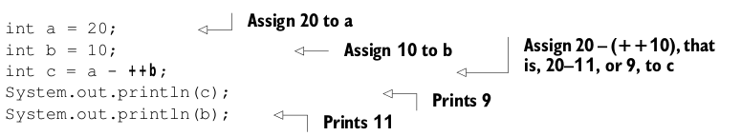
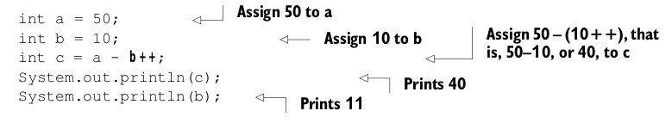
++ AND -- ( UNARY INCREMENT AND DECREMENT OPERATORS )

Slide 17
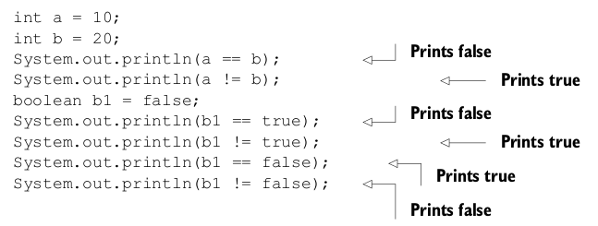
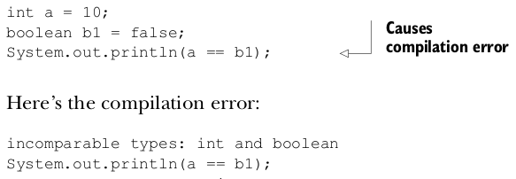
Relational operators
COMPARING PRIMITIVES FOR EQUALITY ( USING == AND !=)
Remember that you can’t apply these operators to incomparable types.

Slide 18
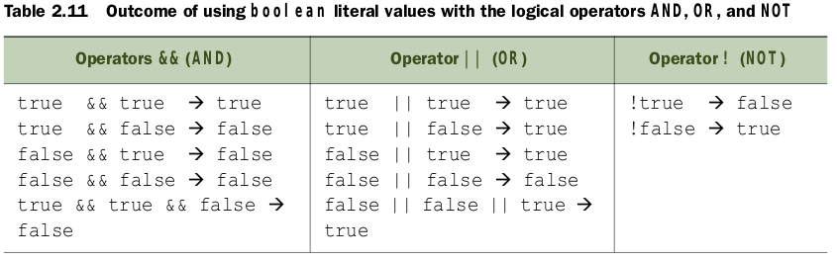
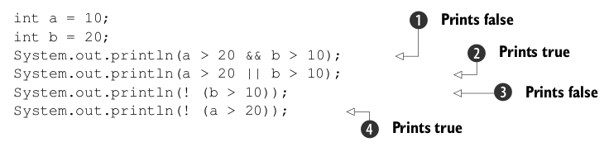
Logical operators
- Logical AND ( && )—Evaluates to true if all operands are true ; false otherwise.
- Logical OR ( || )—Evaluates to true if any or all the operands are true .
- Logical negation ( ! )—Negates the boolean value. Evaluates to true for false and vice versa.

Slide 19
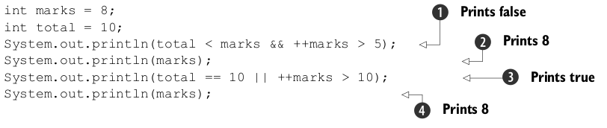
&& AND || ARE SHORT - CIRCUIT OPERATORS
The && operator returns true only if both the operands are true . If the first operand to this operator evaluates to false , the result can never be true . Therefore, && does not evaluate the second operand.
- Similarly, the || operator does not evaluate the second operator if the first operand evaluates to true .

Slide 20
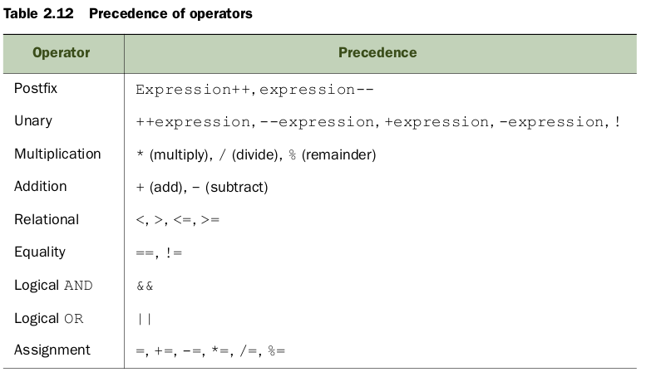
Operator precedence
The operator on top has the highest precedence, and operators within the same group have the same precedence and are evaluated from left to right.

Slide 21
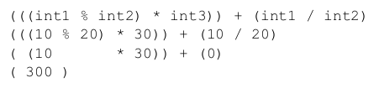
Operator precedence
Use parentheses to override the default operator precedence

Slide 22
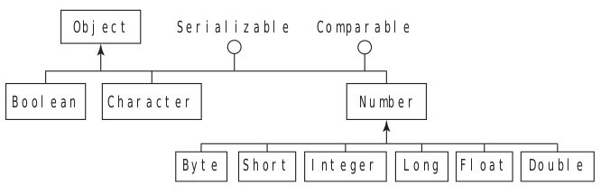
Wrapper classes
Java defines a wrapper class for each of its primitive data types. The wrapper classes
are used to wrap primitives in an object, so they can be added to a collection object. Wrapper classes help you write cleaner code, which is easy to read.
Class hierarchy of wrapper classes

Slide 23
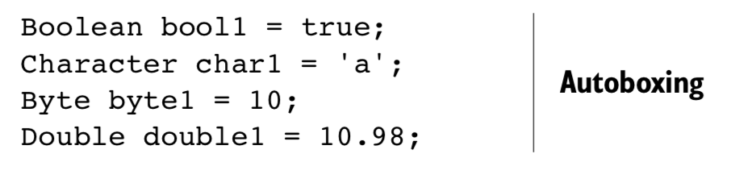
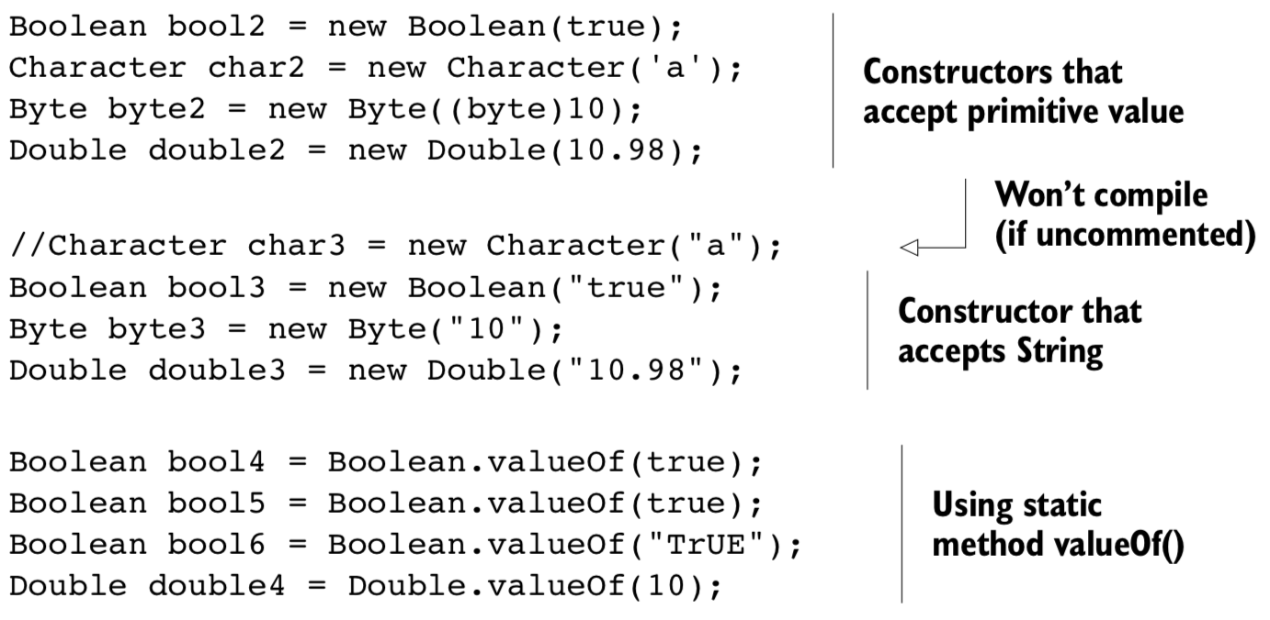
Creating objects of the wrapper classes
You can create objects of all the wrapper classes in multiple ways:
- Assignment—By assigning a primitive to a wrapper class variable (autoboxing)
- Constructor—By using wrapper class constructors
- Static methods—By calling static method of wrapper classes, like, valueOf()
You can assign a primitive value directly to a reference variable of its wrapper class type—thanks to autoboxing. The reverse is unboxing, when an object of a primitive wrapper class is converted to its corresponding primitive value.
All the wrapper classes define constructors to create an object using a corresponding primitive value or as a String (except Character). NOTE: The wrapper classes are immutable

Slide 24
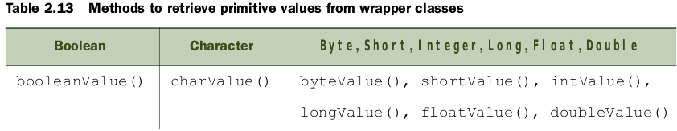
Retrieving primitive values from the wrapper classes

Slide 25
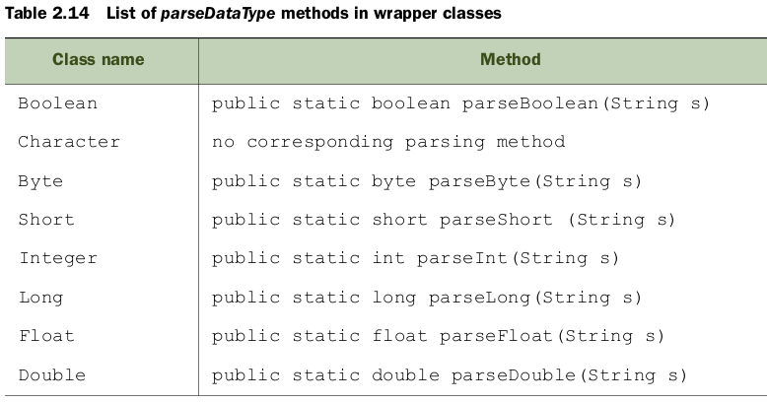
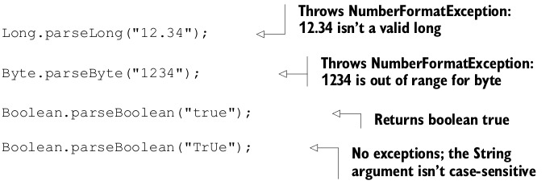
Parsing a string value to a primitive type
All these parsing methods throw NumberFormatExceptions for invalid values.
Boolean.parseBoolean(). This method returns false when ever the string it parses is not equal to “true” (case-insensitive comparison)

Slide 26
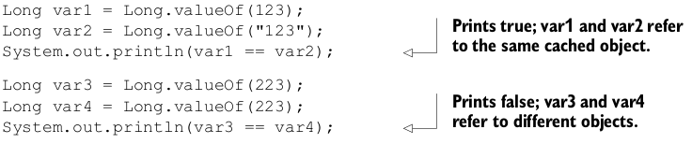
Difference between using the valueOf method and constructors of wrapper classes
The valueOf() method returns an object of the corresponding wrapper class when it’s passed an argument of a primitive type or String .
Wrapper classes Byte , Short , Integer , and Long cache objects with values in the range of -128 to 127 . The Character class caches objects with values 0 to 127 . These classes define inner static classes that store objects for the primitive values -128 to 127 or 0 to 127 in an array. If you request an object of any of these classes, from this range, the valueOf() method returns a reference to a predefined object; otherwise, it creates a new object and returns its reference

Slide 27
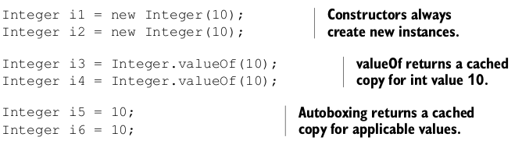
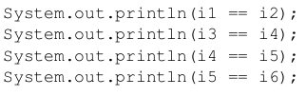
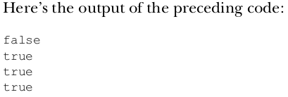
Comparing objects of wrapper classes
You can compare objects of wrapper classes for equality by using the method equals or the comparison operator, that is, == . Method equals() always compares the primitive value stored by a wrapper instance, and == compares object references. The operator == returns true if the variables being compared to refer to the same instance.

Slide 28
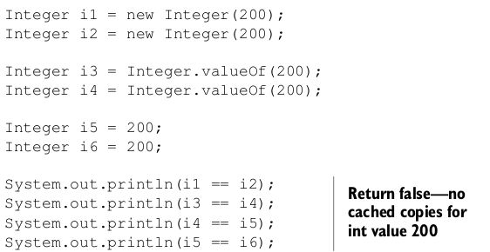
Comparing objects of wrapper classes (cont.)
if you replace == with equals() in the preceding code, the code will output true for all comparisons.
SUMMARY:
- Cached instances exist for the wrapper Boolean class for the values true and false .
- The Character class caches instances with values from 0 to 127 .
- Classes Byte , Short , Integer , and Long cache instances for values -127 to 128 .
- No cached instances exist for the Float and Double wrapper classes.

Slide 29
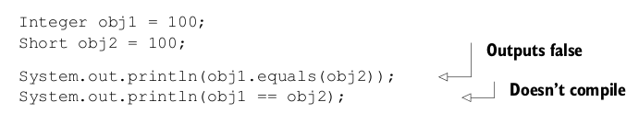
Comparing objects of wrapper classes (cont.)
NOTE: Objects of different wrapper classes with same values are not equal. Using equals() with such instances will return false . If you use == with such instances, the code won’t compile.

Slide 30
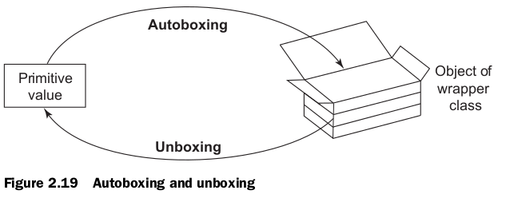
Autoboxing and unboxing
Autoboxing is the automatic conversion of a primitive data type to an object of the corresponding wrapper class (you box the primitive value). Unboxing is the reverse process (you unbox the primitive value)
Unboxing a wrapper reference variable, which refers to null , will throw a NullPointerException

Slide 31
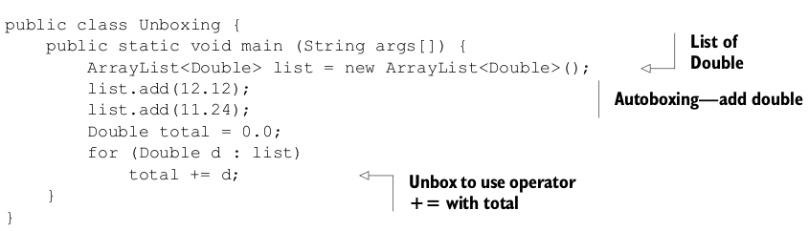
Autoboxing and unboxing (example)
NOTE: Wrapper classes are immutable. Adding a primitive value to a
wrapper class variable doesn’t modify the value of the object it refers to. The
wrapper class variable is assigned a new object.

Slide 32
Exercise
Create a API (Calc) that permit:
  - Add and Subtract
  - Multiply, Divide, and obtain the Module of two value
  - Using Unit Test, test the API
    Example: Calc.add(2,4) + Calc.add(2,5)
    And so on for each method
NOTE: create one using the primitive value and other using the wrapper classes.

Slide 33
Nonaccess Modifiers
...

